Slide 1
Изкуствения интелект в съвременния свят
Иван Койчев
Професор в ФМИ на СУ“Св. Кл. Охридски“

Slide 2

Where Are We?

Slide 3

Google’s Information Retrieval uses: – Natural Language Processing (NLP); – Machine Learning (ML); – User Modelling (UM); – Question Answering (QA); – Knowledge Representation (KR) – ontologies…

Slide 4
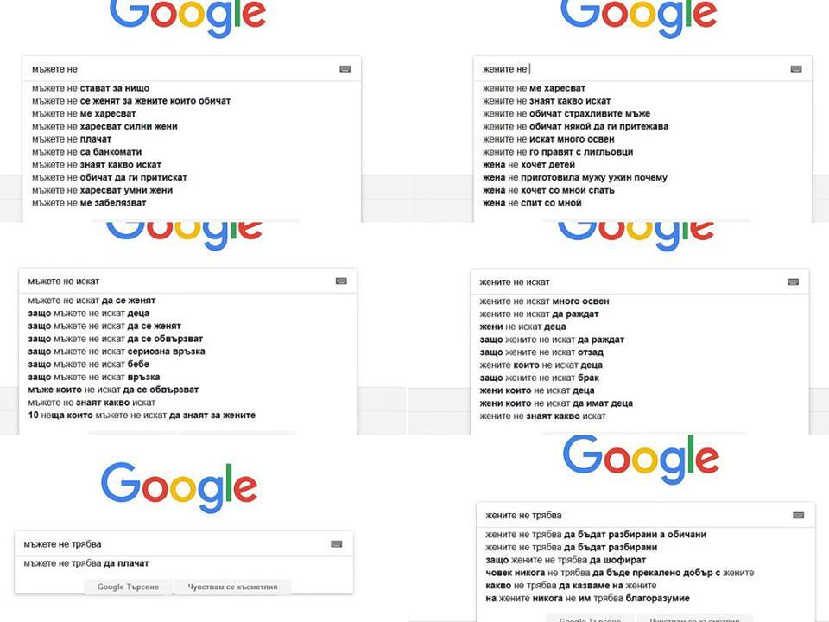

Slide 5
More Google’s AI
AlphaGo, won the game Go against world champion, March 25, 2016 Google DeepMind
Machine Translation
Google Brain Project: TensorFlow, speech recognition
image recognition, for Google indexing
image enhancement – involves restoring or filling in detail missing from images;
Cloud Machine Learning Engine,
self-driving cars
Word Embedding - Word2Vec

Slide 6
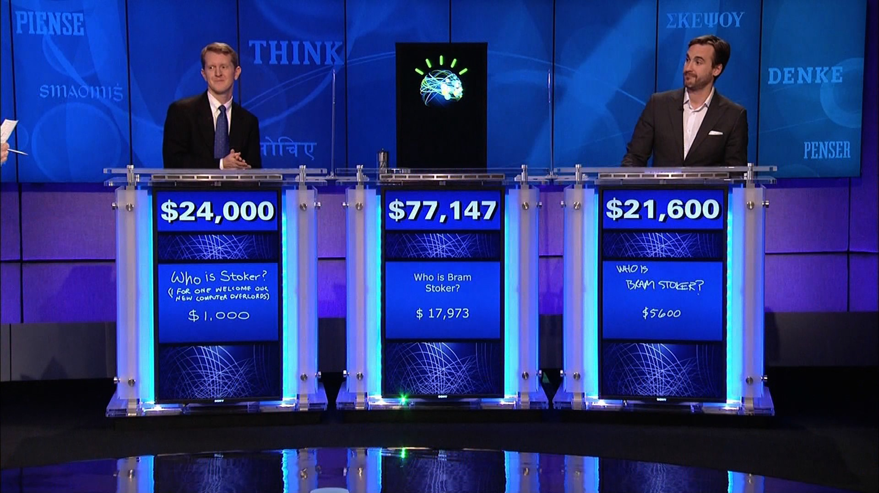
QA: IBM Watson won Jeopardy!

Slide 7
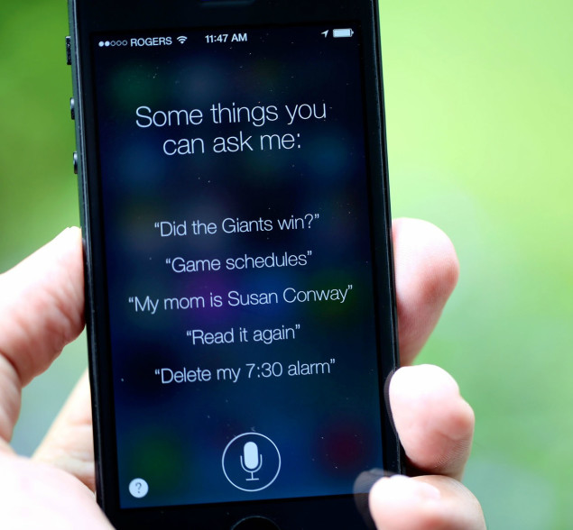
Dialog: Apple Siri

Slide 8
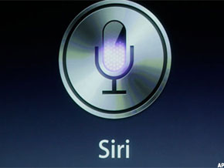
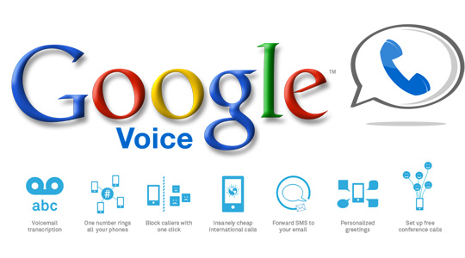
automatic speech recognition: Apple Siri, Amazon’s Alexa, Microsoft’s Cortana, and Google’s Assistant.

Slide 9
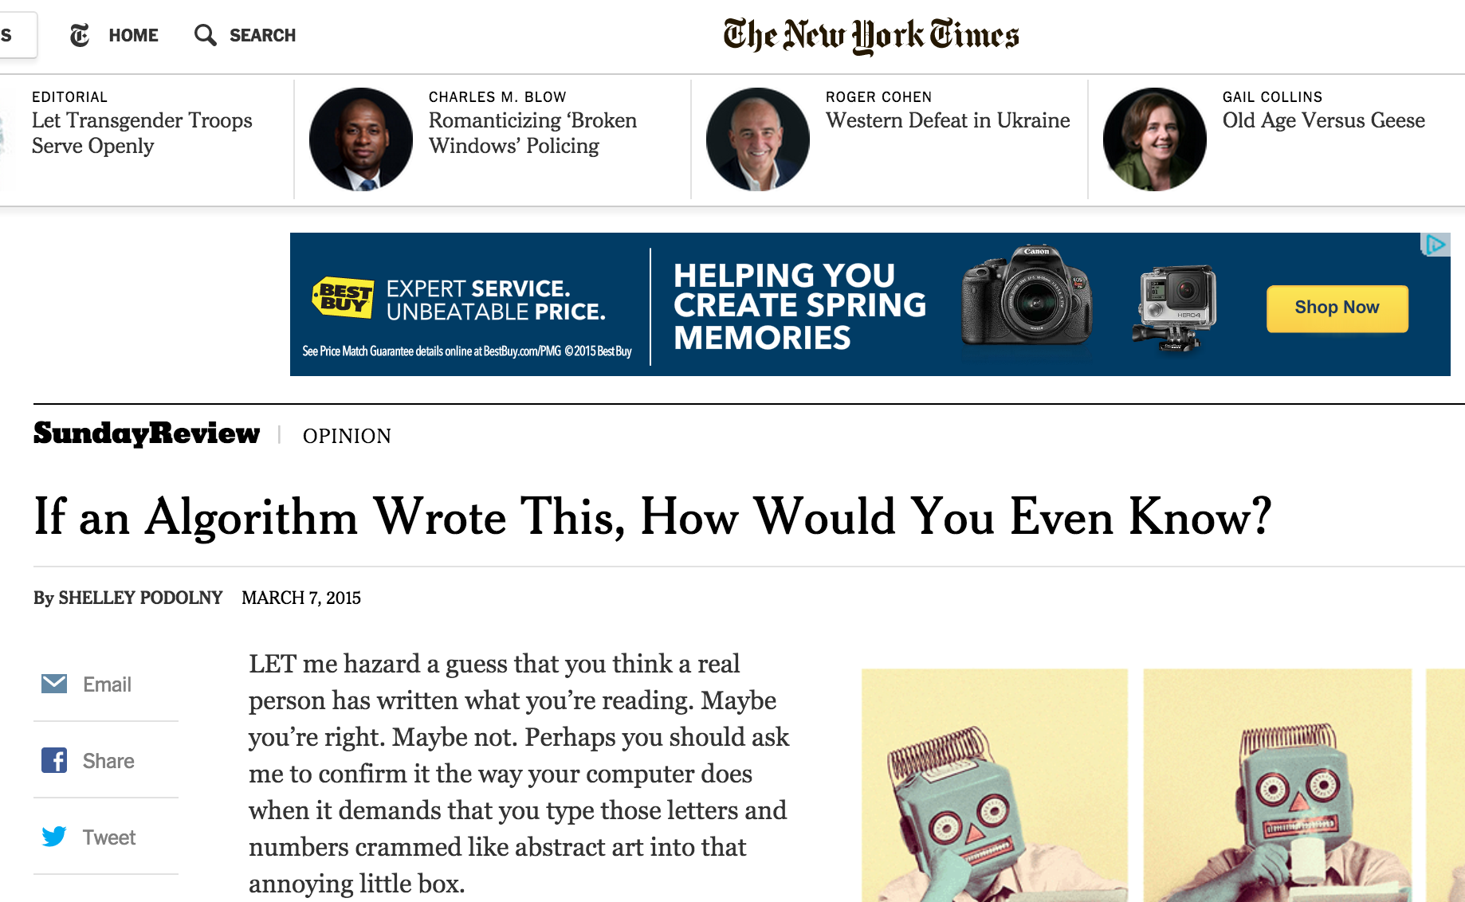
Generation: Computers Write News!

Slide 10
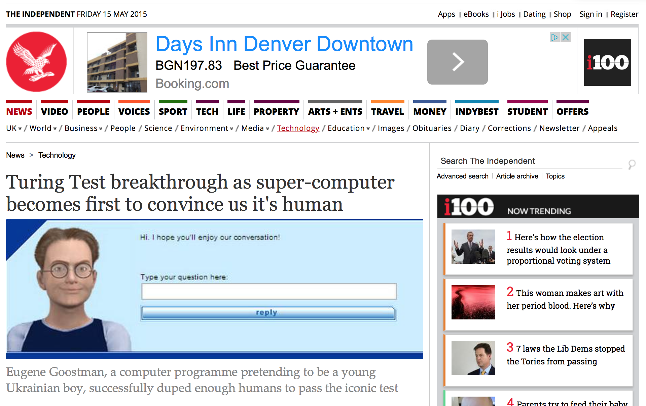
The Turing Test Passed?

Slide 11


Reality check…

Slide 12
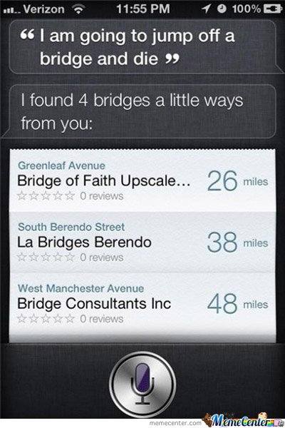
Dialog: Siri

Slide 13
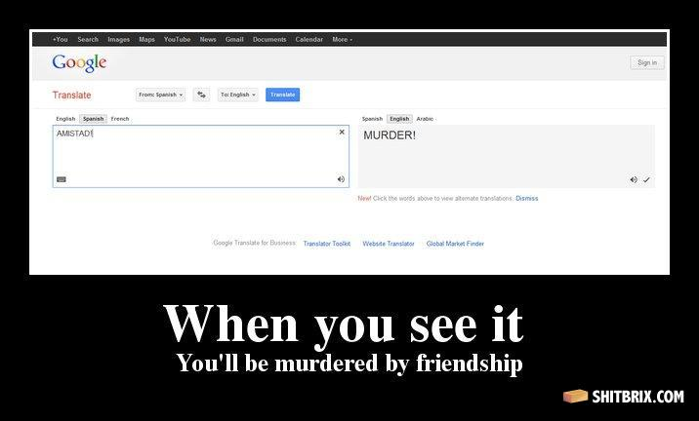
MT: Google Fails

Slide 14
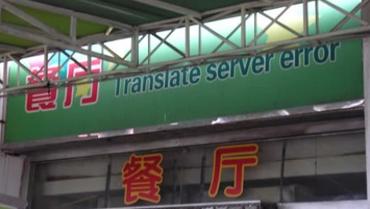
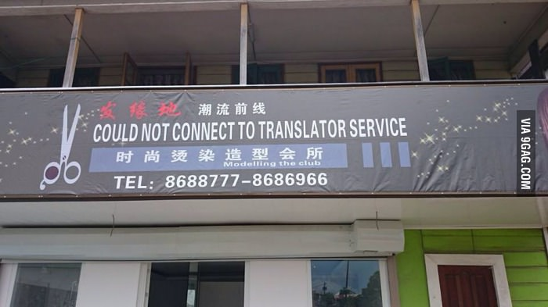
MT Fails?

Slide 15
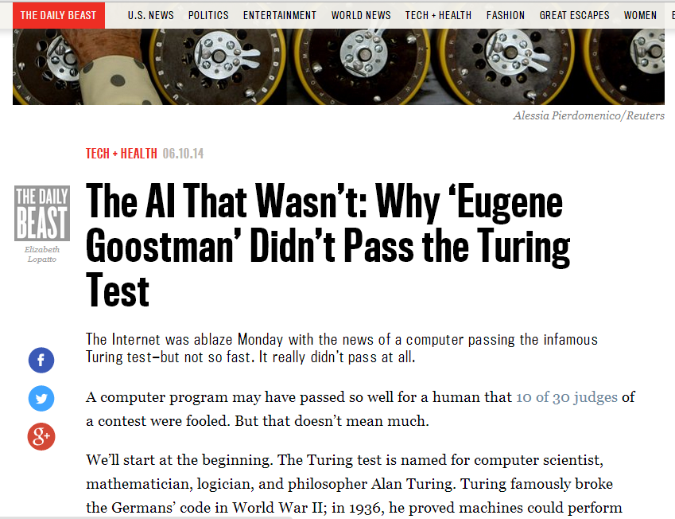
Turing Test: Not Passed?

Slide 16
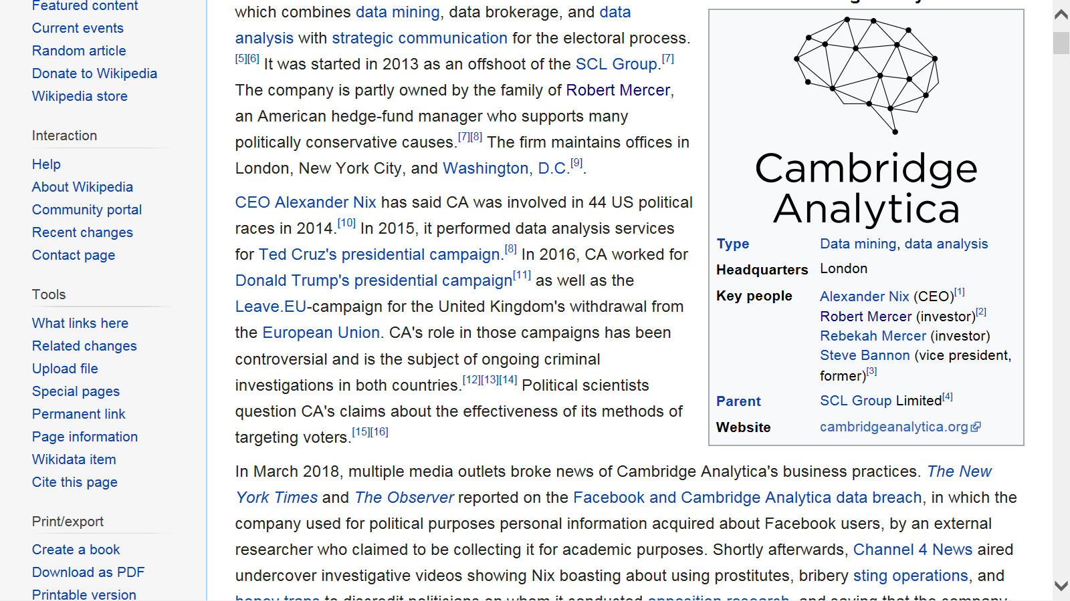

Slide 17
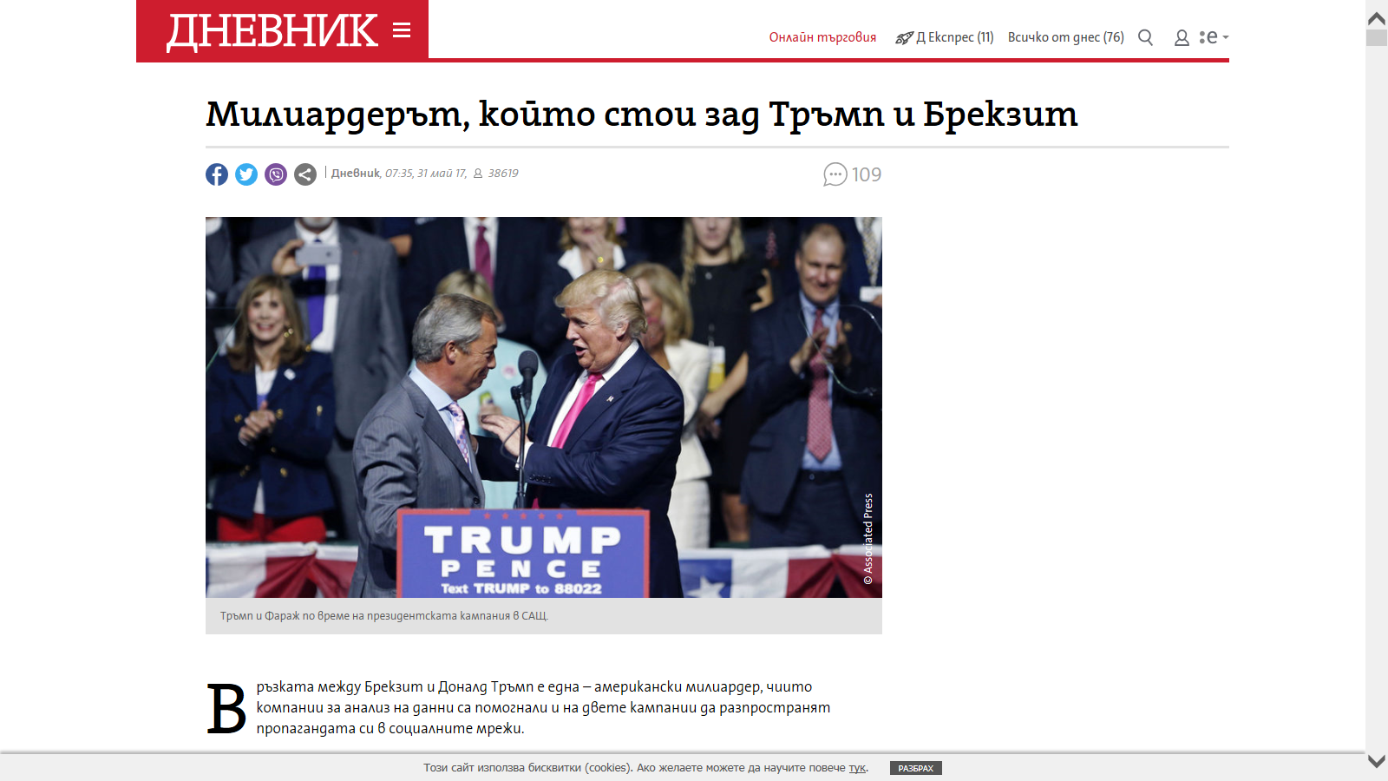

Slide 18
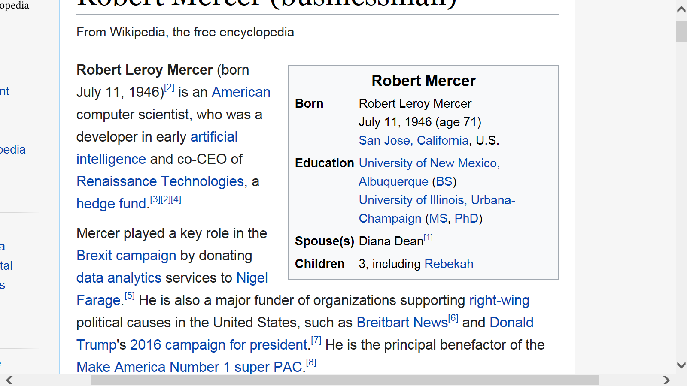
Robert L. Mercer receives the 2014 ACL Lifetime Achievement Award

Slide 19
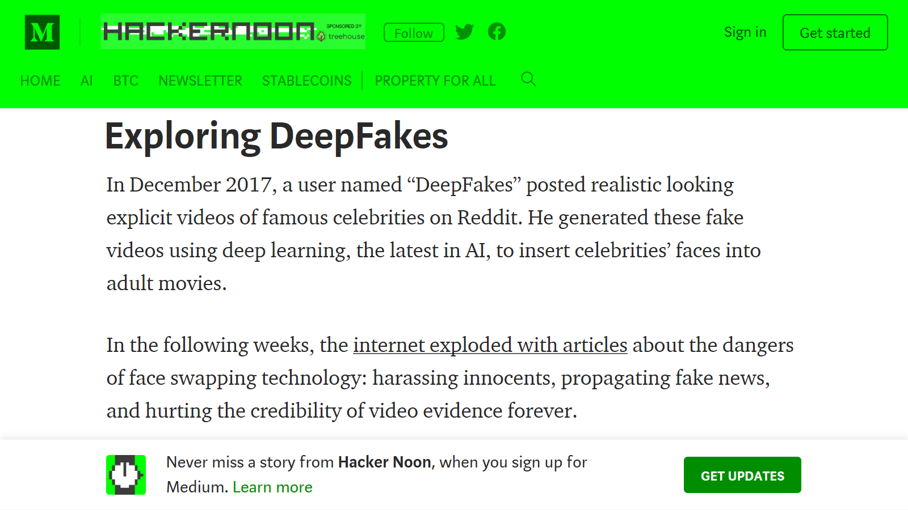

Slide 20
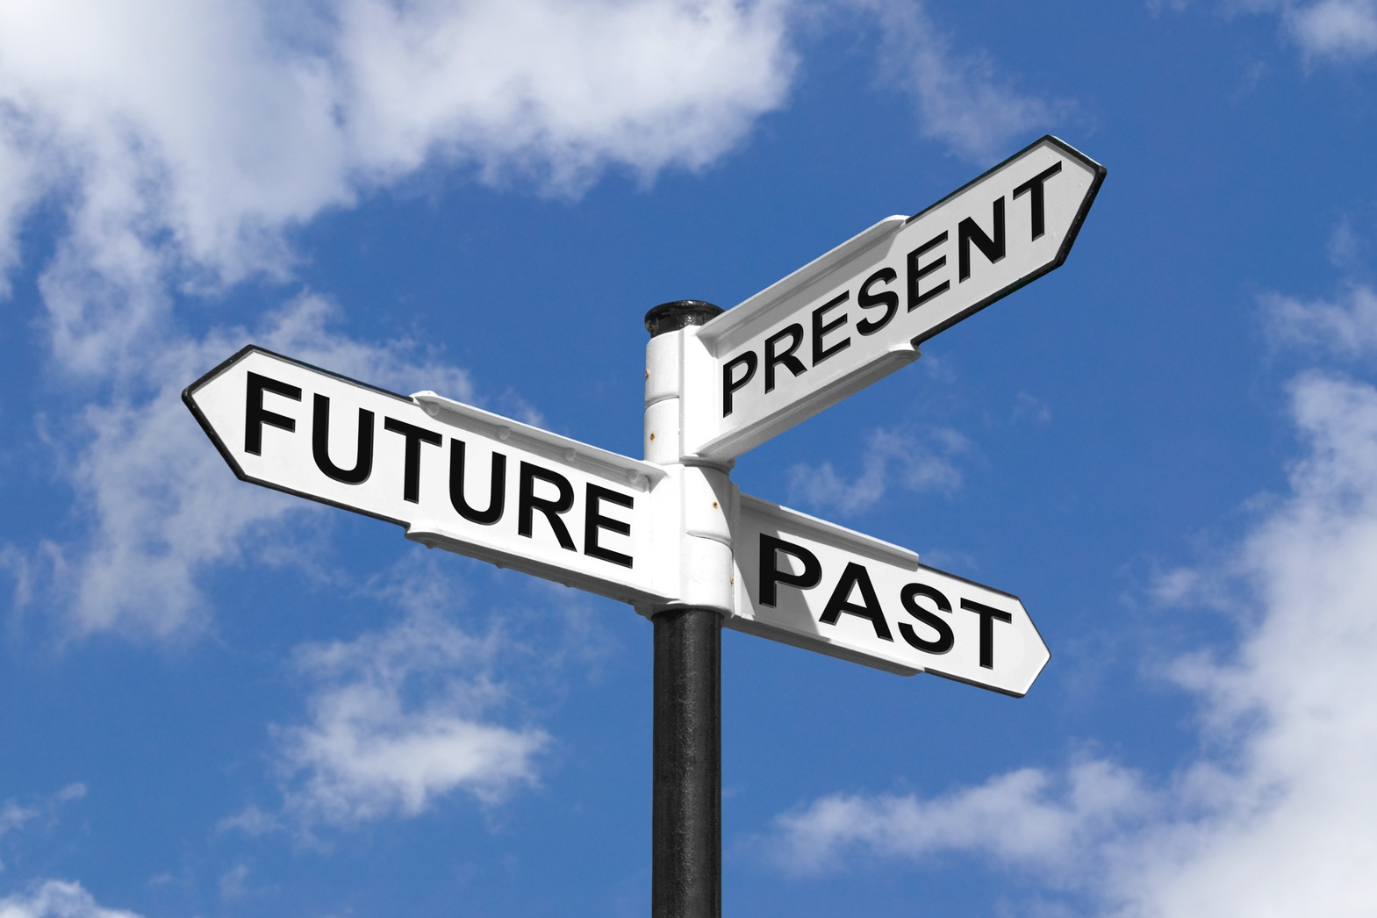

Slide 21
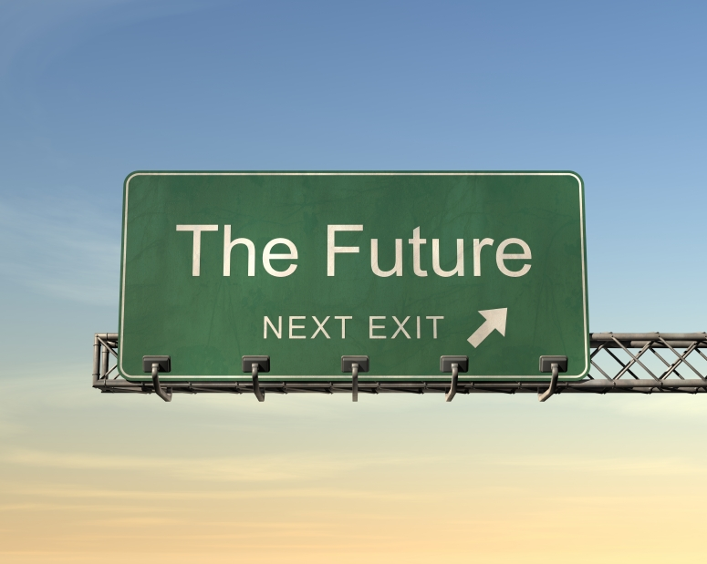

Slide 22
Why Stephen Hawking and Bill Gates Are Terrified of Artificial Intelligence TheHuffingtonPost.com dated 09/04/2015
“https://www.huffingtonpost.com/james-barrat/hawking-gates-artificial-intelligence_b_7008706.html
James Barrat - author, of “Our Final Invention: Artificial Intelligence and the End of the Human Era”

Slide 23
Why Stephen Hawking and Bill Gates Are Terrified of Artificial Intelligence 09/04/2015
“We don’t know how to control super intelligent machines.”
More than 50 nations are developing battlefield robots.
Advance data-mining tools now in use by the U.S. National Security Agency
“They’ll become self-protective and seek resources to better achieve their goals. They’ll fight us to survive, and they won’t want to be turned off.”
In the next decade, artificial intelligence-enhanced products are projected to create trillions of dollars in economic value.

Slide 24
The Russian president Putin says:
the nation that leads in AI will be the ruler of the world
It comes with colossal opportunities, but also threats.
Artificial intelligence is the future, not only for Russia, but for all humankind
Sep 4, 2017
https://www.theverge.com/2017/9/4/16251226/russia-ai-putin-rule-the-world

Slide 25
Tech companies go for broke on AI talent
No salary high enough if a candidate has the right credentials, including that Ph.D
Typical AI specialists, including both Ph. D.s fresh out of school and people with less education and just a few years of experience, can be paid from $300,000 to $500,000 a year or more in salary and company stock.
October 30, 2017
http://gulfnews.com/business/sectors/features/tech-companies-go-for-broke-on-ai-talent-1.2115444

Slide 26
Проекти с участие на наши студенти
NLP & ML
Sentiment and emotion analysis,
Irony and sarcasm recognition;
Author detection, profiling and obfuscations;
Chat boots and Question answering;
Trolls and trolls’ comments detection
Fake new exposure and Automated fact checking
Text Summarization …
Big data analytics
…

